Slide 1

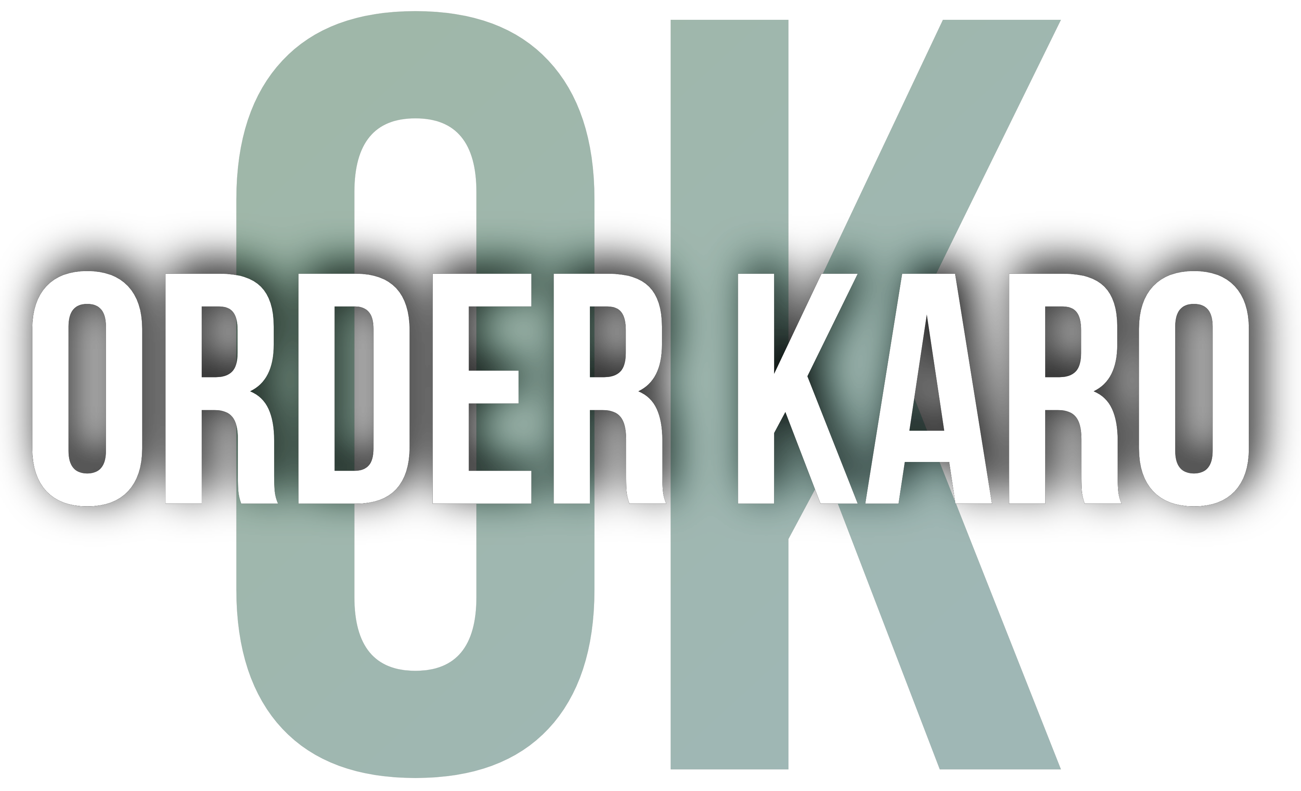
Presented by 1. Gajanan Joshi
2. Kumar Wayadande
3. Riyan Shaikh
4. Utkarsha Memane

Slide 2

OrderKaro
The Grocery Ordering System website (OrderKaro) is an online platform that aims to simplify the grocery shopping experience for customers.
Our website provides an easy-to-use interface that allows customers to browse through a wide range of grocery items, add them to their cart, and complete their purchase with just a few clicks.
We are committed to providing high-quality products and timely delivery to ensure that our customers have a hassle-free shopping experience.

Slide 3

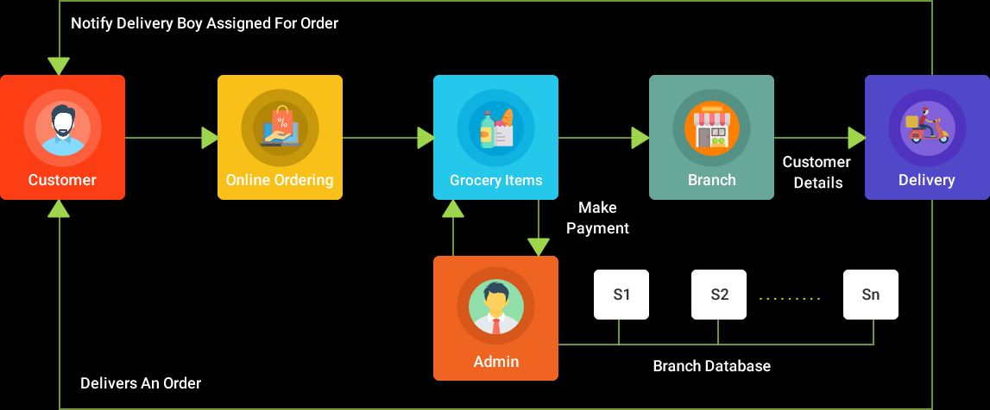
Basic Idea
The basic idea of a grocery ordering system is to provide a platform for customers to order groceries online and have them delivered to their doorstep. The system typically consists of a website that allows customers to browse a selection of products, add items to cart, and complete their order by entering payment and delivery information.

Slide 4
System Features :
1. Shopping Cart – Easy to add and remove products in shop.
2. Payment Options - The system offers payment with variety of credit/debit cards.
3. Easy To Use - The system is user friendly. All the controls are well placed to assist user while handling the website.
4. Product Catalog - The catalog should include product information such as prices, images, descriptions.

Slide 5
Technologies Used
1. HTML ( Hypertext Markup Language )
2. CSS ( Cascading Style Sheet )
3. Bootstrap
4. EJS (Embedded JavaScript Templating )
5. ExpressJS (Express JavaScript )
6. NodeJS ( Node JavaScript )
7. MongoDB ( Database )

Slide 6
Conclusion
In conclusion, a grocery ordering system provides a convenient and efficient way for customers to order groceries online. With features such as a comprehensive product catalog, search and shopping cart, multiple payment options, delivery options, order tracking and etc. s, the system is designed to provide a seamless and personalized shopping experience for customers

